Slide 1

Welcome To CCL Training!
We’ll get started at the top of the hour.
In the meantime...
  Share in the chat: where you’re joining from
  Follow us online (FB, Twitter, TikTok, Instagram, and BlueSky)
  Post questions using the Q&A button
  Tonight’s Slides: cclusa.org/FOFA-senate-slides
Notes:
Thanks for joining us tonight! We’re so glad you’re here!
We’ll get started at the top of the hour, but in the meantime, follow us online at:
BlueSky: https://cclusa.org/bluesky
Facebook: https://www.facebook.com/CitizensClimateLobby
Instagram: https://www.instagram.com/citizensclimate/
X (Twitter): https://twitter.com/citizensclimate
TikTok: https://www.tiktok.com/@citizensclimate
Share in the chat where you’re joining from if you’d like!
Slides for tonight:
cclusa.org/FOFA-senate-slides

Slide 2
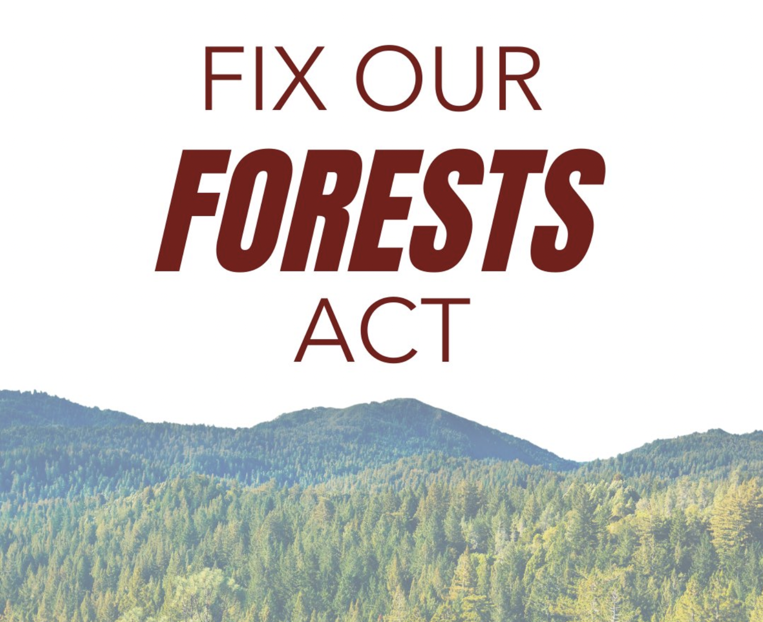

The Fix Our Forests Act
May 8th, 2025
Presentation Slides: https://cclusa.org/FOFA-senate-slides
Notes:
Welcome to tonight’s Citizens’ Climate Lobby Thursday Night Live Training on the Fix Our Forests Act. We’re glad you’re here!
In this session, we’ll take a close look at the Senate version of this important bipartisan legislation and explore why it’s critical for the climate, for forest health, and for wildfire resilience.

Slide 3


About the Speakers
Dana Nuccitelli
Research Manager for Citizens’ Climate Lobby
Jennifer Tyler
Vice President of
Government Affairs
for Citizens’ Climate Lobby
Notes:
Dana Nuccitelli is Citizens’ Climate Lobby’s Research Manager. He’s a well-known climate science communicator and environmental scientist who translates complex scientific findings into accessible, actionable insights for volunteers and policymakers. Dana plays a key role in grounding CCL’s policy work in the latest research and evidence.
Jennifer Tyler is CCL’s Vice President of Government Affairs. With years of experience on Capitol Hill, Jenn leads CCL’s legislative strategy and engagement with members of Congress. She ensures our policy work is timely, impactful, and aligned with the changing political landscape.

Slide 4

About the Speakers
Dana Nuccitelli
Research Manager for Citizens’ Climate Lobby
Jennifer Tyler
Senior Director of
Government Affairs
for Citizens’ Climate Lobby
Danny Richter
Policy Fellow for Citizens’ Climate Lobby
Notes:
Dana Nuccitelli is CCL research coordinator, an environmental scientist and climate journalist. Jenn Tyler is CCL’s senior director of government affairs.

Slide 5
Three Learning Goals
Learn about the Senate version of the Fix Our Forests Act (FOFA)
Explore some of the critiques of the bill and why CCL supports it
Discuss CCL’s planned role in supporting FOFA

Slide 6
Why CCL Supports This Bill
It’s good for our forests and the climate. Healthier forests store more carbon, keeping it out of the atmosphere. That’s a climate win.
It builds bipartisan common ground, bringing Congress together on forest health and permitting reforms — both vital to climate progress.
It needs our help to pass. Passage is not a guarantee, and CCL’s nonpartisan grassroots advocacy is needed to secure this climate win.

Slide 7
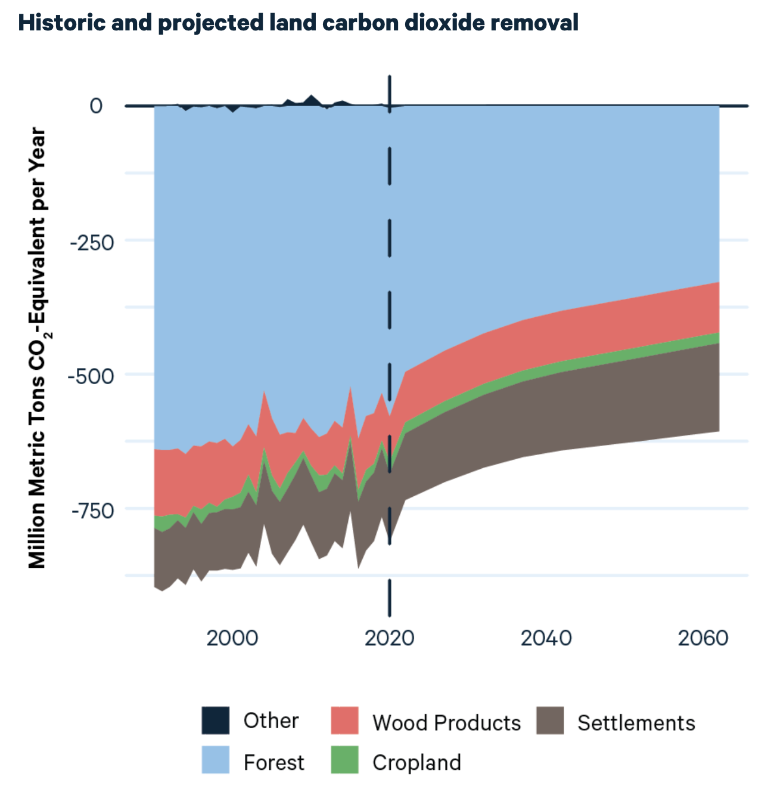
Why This is Important
American forests currently offset 12% of our annual climate pollution
That will decline over time due to stressed, burning, and aging forests if we don’t take action
Can be offset through efforts like reforestation & wildfire mitigation
Notes:
https://www.rff.org/news/press-releases/forests-will-sequester-less-carbon-in-the-coming-decades-afforestation-programs-could-change-that/

Slide 8
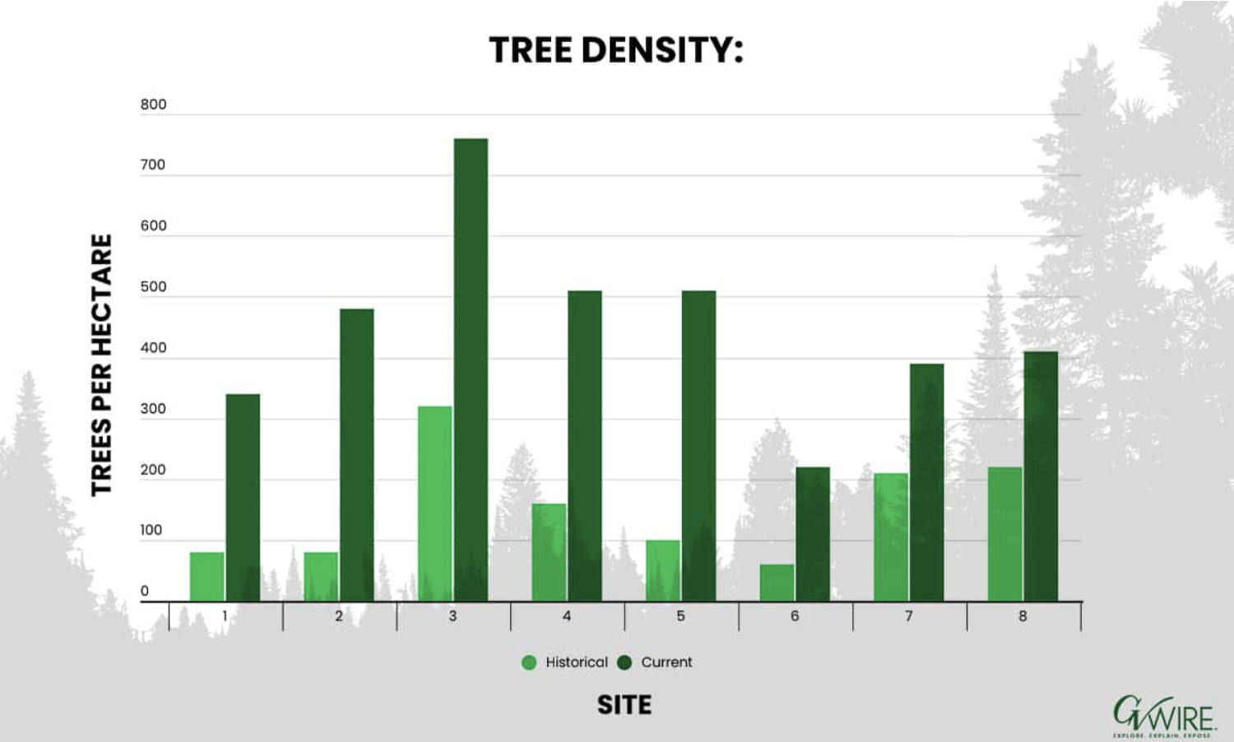
Why are Wildfires Worsening?
Climate change
Forest Management
  Colonialism replacing Indigenous cultural burning
  Aggressive fire suppression
  Early timber harvest practices removing large trees
hotter + drier + denser forests = megafires
Notes:
https://www.publish.csiro.au/wf/Fulltext/WF22155
https://gvwire.com/2020/09/15/california-forests-80-600-denser-than-150-years-ago-uc-researcher-says-biomass-is-one-of-the-answers/

Slide 9
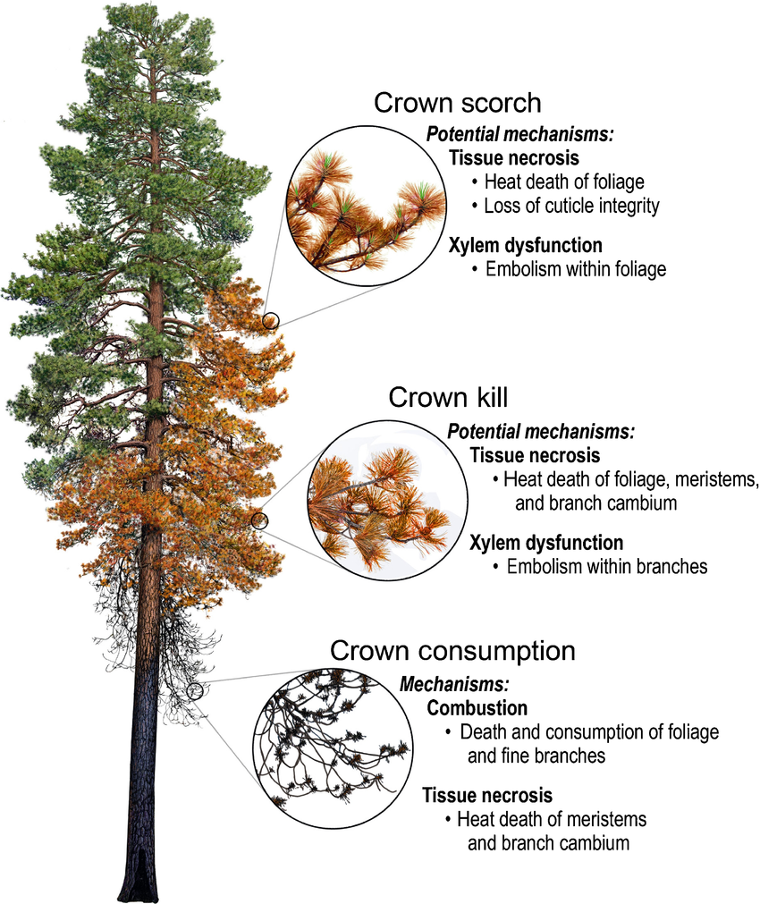
Key Wildfire Concepts
Canopy/crown fires: hottest and most destructive.
Canopy fuels: Live or dead branches and leaves in the crown of a tree.
Surface fires: burn surface fuels, and can become crown fires.
Surface fuels: Loose surface litter on the soil surface, e.g. fallen leaves or needles, twigs, bark, cones, and small branches
Ladder fuels: Vertical fuels that allow fire to carry from surface fuels into the crowns of trees or shrubs.
Drawing by R. Van Pelt
Notes:
https://www.fs.usda.gov/nwacfire/home/terminology.html
Tree crown injury from wildland fires: causes, measurement and ecological and physiological consequences - Scientific Figure on ResearchGate. Available from: https://www.researchgate.net/figure/Post-fire-crown-injury-in-Pinus-ponderosa-drawing-by-R-Van-Pelt-Heat-from-fires_fig1_352262204 [accessed 6 May 2025]

Slide 10
Wildfire mitigation methods
Driving concept: reduce the likelihood of a surface fire
becoming a crown fire
Hazardous fuel reduction/thinning: Removing excess fuel to keep forests healthy and reduce wildfire risk
Chipping: Lowers fire height by burning faster-igniting fuel on the floor, saving tree tops. Creates a low-intensity, low–to-the-ground burn. “Understory burn.”
Prescribed fire: Any fire ignited by management actions under certain, predetermined conditions to meet specific objectives related to hazardous fuels or habitat improvement. A written, approved prescribed fire plan must exist, and NEPA requirements must be met, prior to ignition.
Notes:
Tree crown injury from wildland fires: causes, measurement and ecological and physiological consequences - Scientific Figure on ResearchGate. Available from: https://www.researchgate.net/figure/Post-fire-crown-injury-in-Pinus-ponderosa-drawing-by-R-Van-Pelt-Heat-from-fires_fig1_352262204 [accessed 6 May 2025]

Slide 11
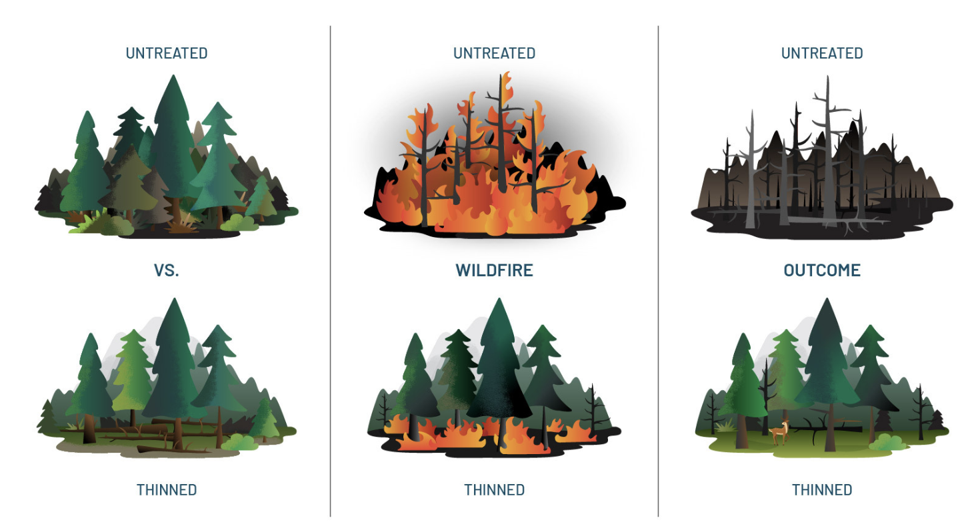
What the Science Says: Wildfires
2023 study found that controlled burns and/or thinning “produced forest conditions at the end of 20 years that were much more resistant to wildfire”
Forest thinning “can be a viable way to mitigate fire risk, as long as it’s done sustainably and arborists are strategic about what trees they’re chopping down”
Notes:
https://community.citizensclimate.org/discuss/viewtopic/3284/40551

Slide 12
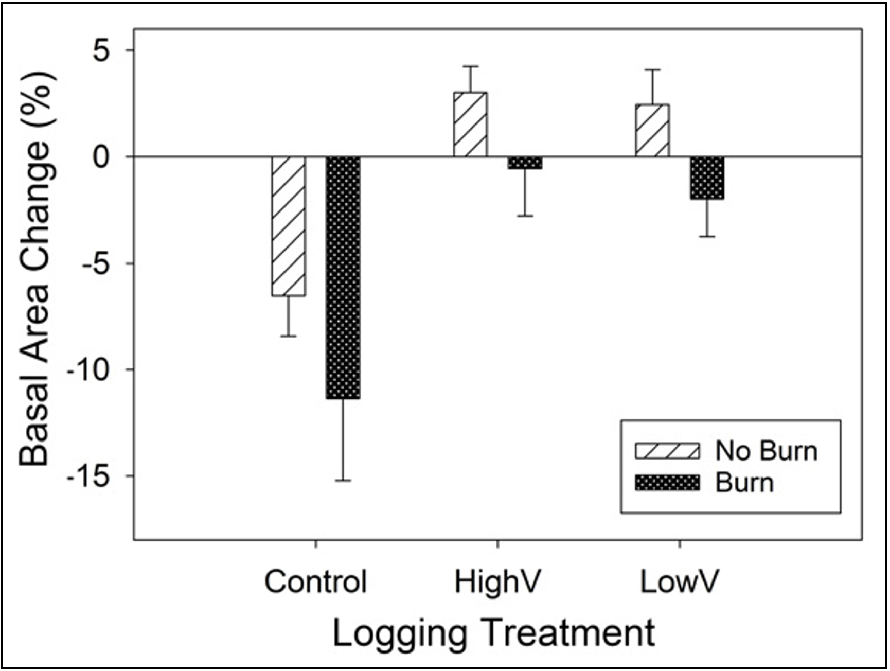
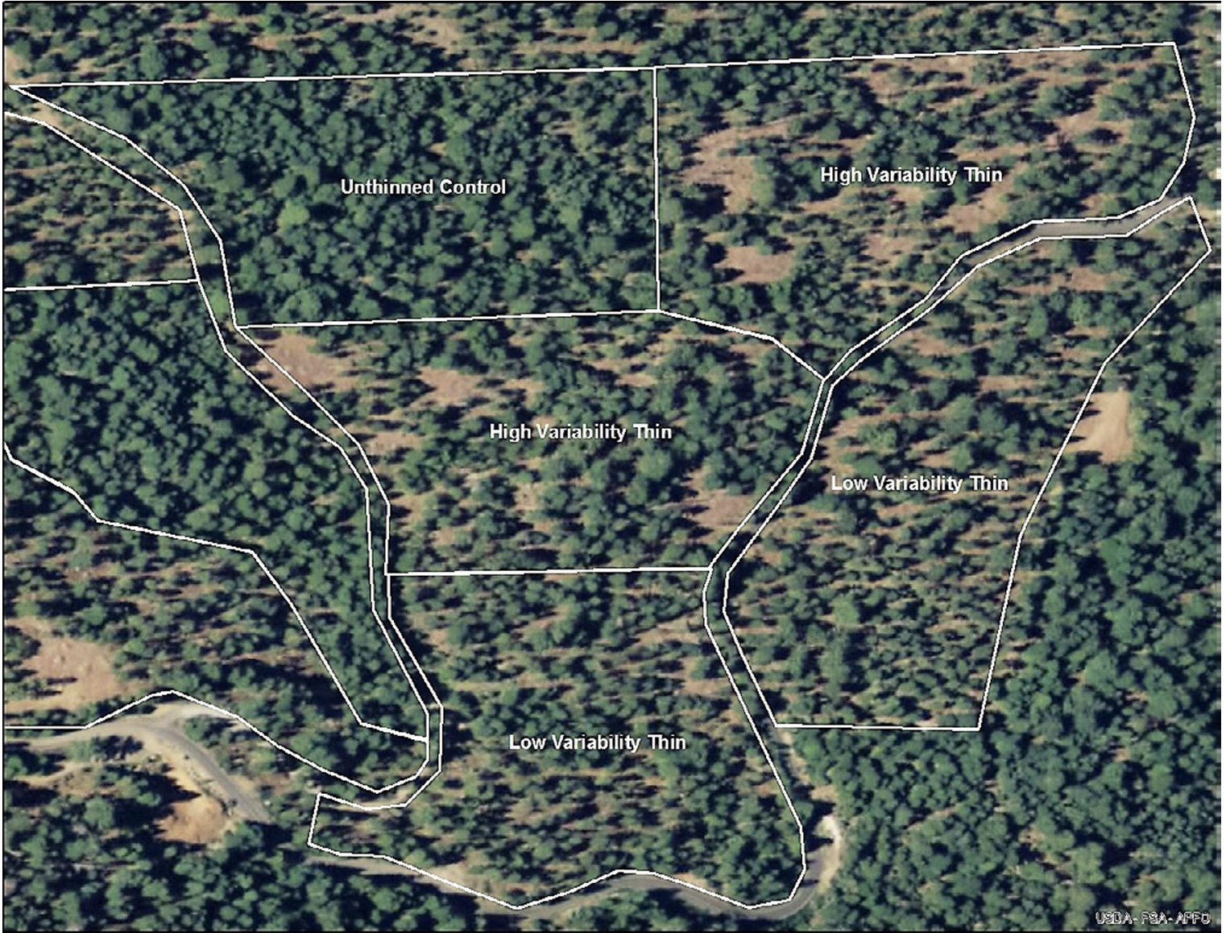
What the Science Says: Droughts
2020 USFS study found that thinned forests were more resilient to extreme drought
Variable thinning plus controlled burns recreated historical forest structure more resilient to wildfires
2025 study similarly found thinner forests mitigate drought by allowing more water to reach the ground
Notes:
https://www.fs.usda.gov/nrs/pubs/gtr/gtr-nrs-p-193papers/28-knapp-gtr_nrs-p-193.pdf
https://agupubs.onlinelibrary.wiley.com/doi/10.1029/2024WR039227

Slide 13
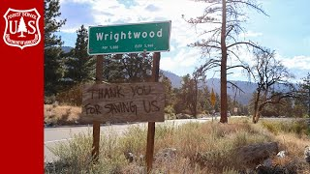

Slide 14
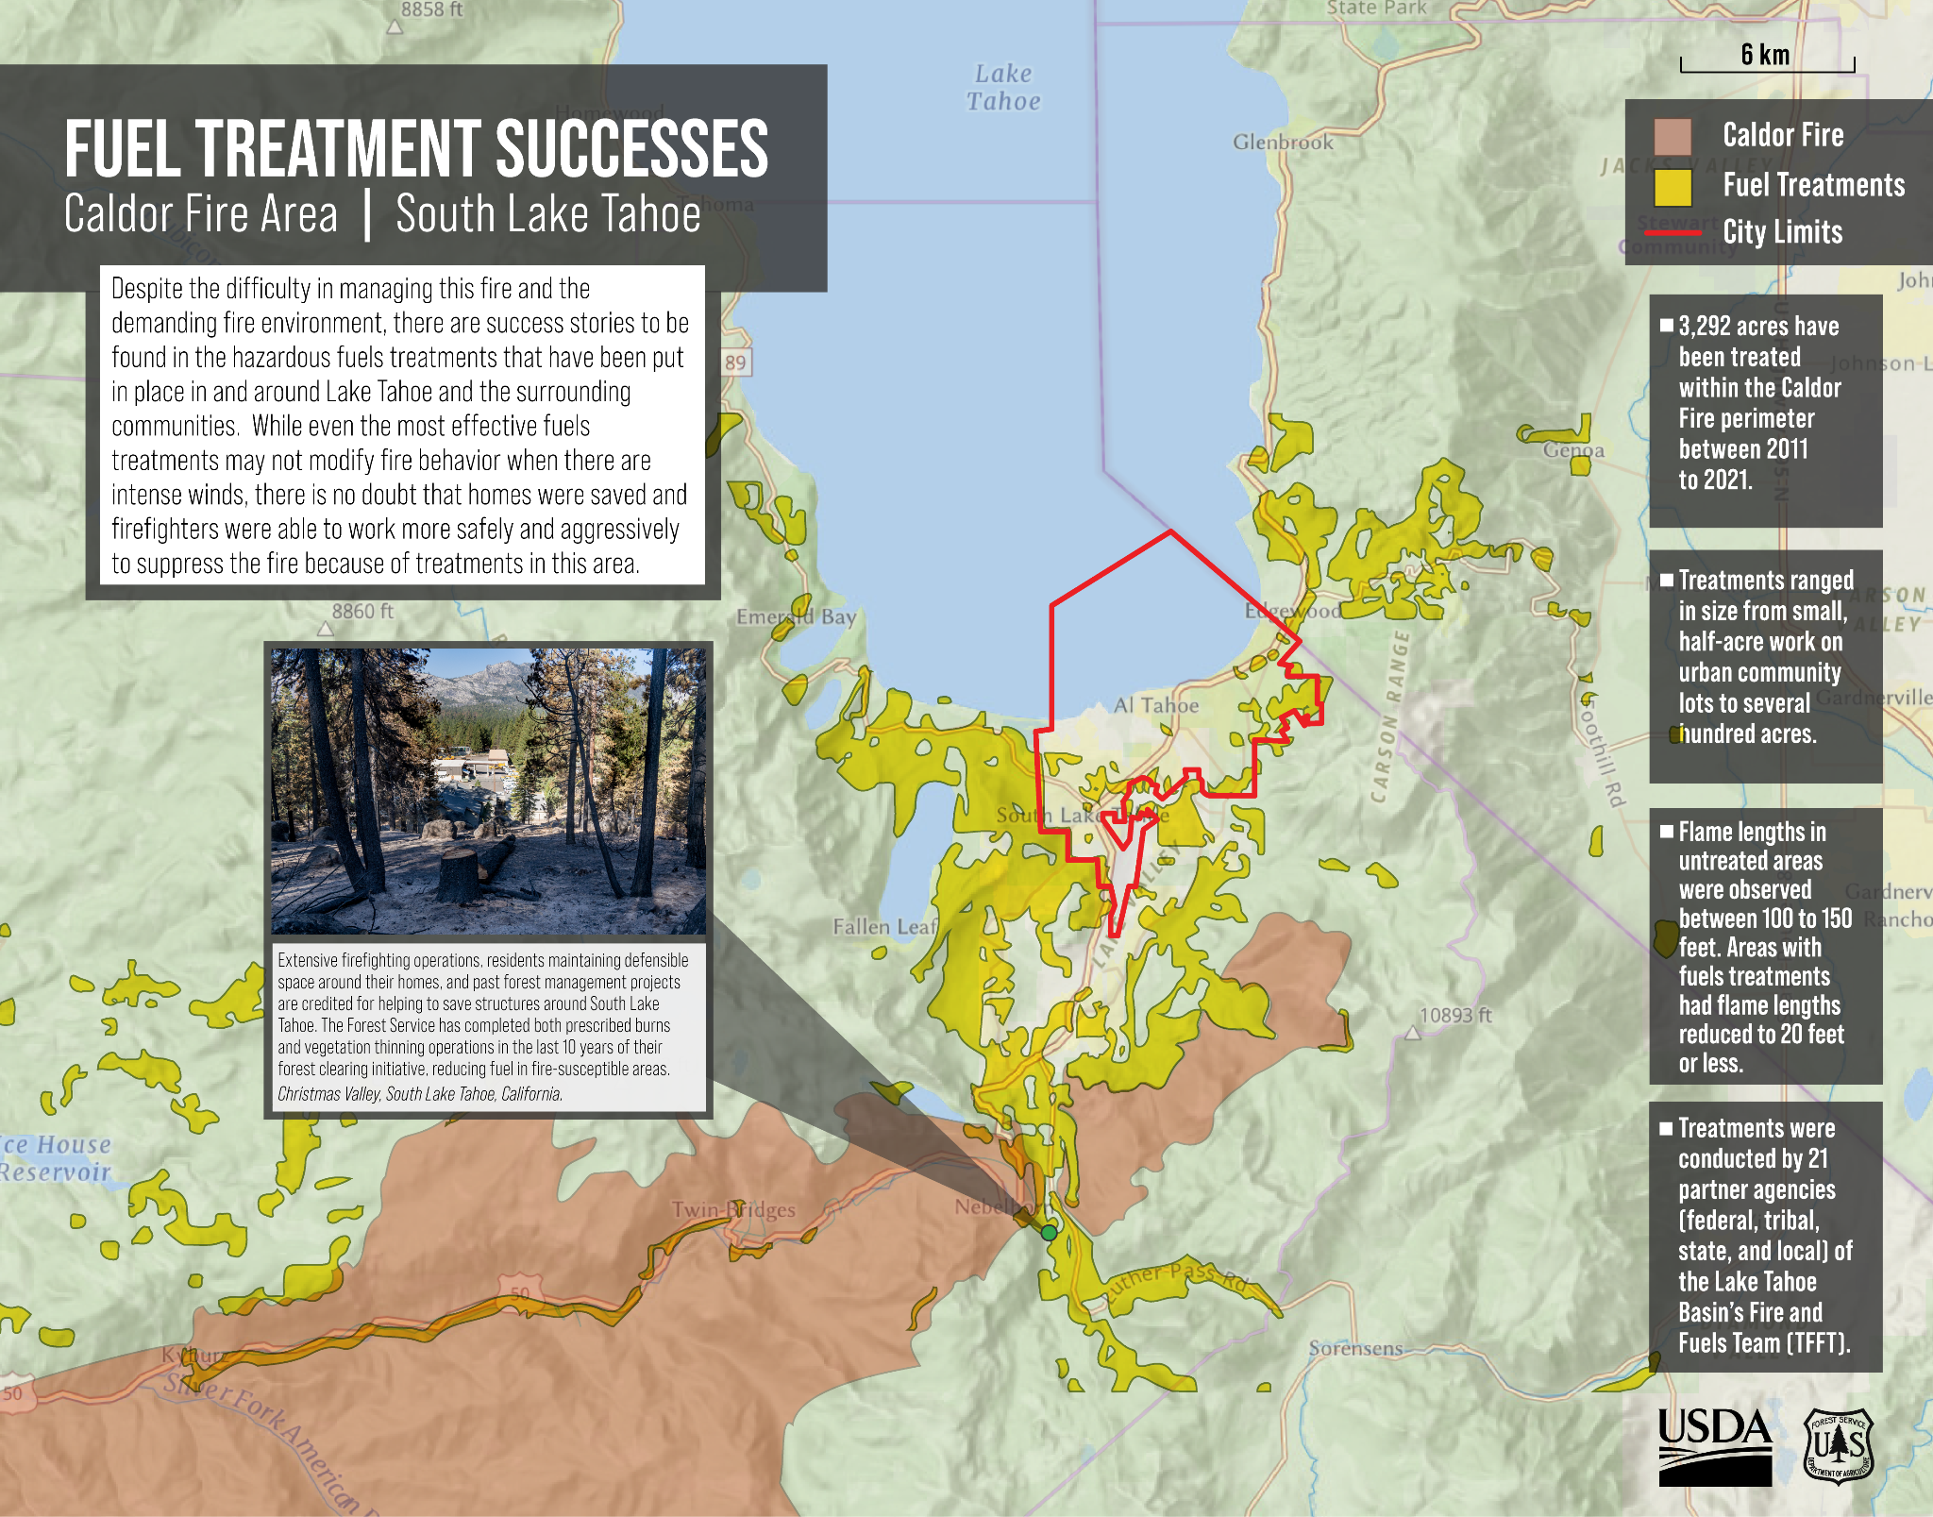
Success story:
The 2021 Caldor Fire avoided South Lake Tahoe thanks to wildfire management treatments
Tahoe is the only currently existing 10,000-acre categorical exclusion area, from the Water Infrastructure Improvements for the Nation Act, Proven Forest Management Act
Notes:
https://www.fs.usda.gov/about-agency/features/caldor-fire-defending-lake-tahoe-basin

Slide 15
FOFA Topline Summary
The Fix Our Forests Act primarily focuses on permitting reform and technology adoption for improved decision making essential to scaling up effective wildfire mitigation
The legislation removes bureaucratic roadblocks that slow down essential forest restoration projects and integrates cutting-edge technology to modernize wildfire decision-making
Notes:
https://www.publish.csiro.au/wf/Fulltext/WF22155

Slide 16
What FOFA does not do
The legislation will not resolve the long-standing workforce and budget constraints that have plagued wildfire mitigation and response for decades
A permanent, well-resourced federal wildfire workforce remains an urgent need
CCL is working with sponsors of the legislation and other Members of the relevant Committees to address staffing and resource concerns through the appropriations process
Notes:
https://www.publish.csiro.au/wf/Fulltext/WF22155

Slide 17
FOFA Major Provisions
Fireshed Management Areas: Establishes a nationwide system to designate the top 20% of wildfire-exposed landscapes for targeted treatment (Sec. 101)
Fireshed Assessments: Requires detailed, science-based wildfire risk analyses and restoration strategies for each designated fireshed. These assessments require local and tribal collaboration in planning and public participation as assessments are initiated (Sec. 105)
Fireshed Registry: Creates a public-facing geospatial database tracking wildfire risk, completed and planned treatments, and project performance (Sec. 103)
Wildfire Intelligence Center: Sets up a new federal coordination hub for real-time wildfire data, modeling, smoke forecasting, and decision support (Sec. 102)
Notes:
https://www.publish.csiro.au/wf/Fulltext/WF22155

Slide 18
FOFA Major Provisions
Emergency Management Authority: Expands use of categorical exclusions and emergency determinations to streamline forest treatment projects (Sec. 106)
Prescribed Fire Reforms: Broadens federal use of prescribed burning, with funding, liability protection, and workforce support (Secs. 131–136)
Litigation and Consultation Reforms: Introduces provisions to limit certain lawsuits against forest health projects (Subtitle C)
Expanded Good Neighbor Authority & Stewardship Contracting: Improves federal–state–tribal collaboration and extends contract timelines to 20 years. These provisions strengthen local and tribal leadership in forest management by expanding who can partner with federal agencies and making long-term stewardship contracts more viable and secure (Secs. 111–112)
Notes:
https://www.publish.csiro.au/wf/Fulltext/WF22155

Slide 19
FOFA Major Provisions
Reforestation & Nursery Investment: Increases capacity for growing and planting trees to restore burned or degraded lands (Secs. 215–216)
White Oak Restoration Initiative: Launches a national program to restore resilient hardwood ecosystems, with a focus on white oak, which are critical to the bourbon making process for storage and flavor development (Subtitle B, Title III)
Biochar Innovation Research: Supports the development, commercialization, and research of biochar through demonstration projects, grants, and policy development (Sec. 301)
Notes:
https://www.publish.csiro.au/wf/Fulltext/WF22155

Slide 20

What the Senate Added
Establishes joint Departments of Interior and Agriculture Wildfire Intelligence Center
Makes wildfire recovery eligible for Joint Chiefs Landscape Restoration Partnership program
Expands programs to protect and restore watersheds, including wildfire management
Increased the House FOFA 120-day lawsuit statute of limitations to 150 days
Notes:
https://www.publish.csiro.au/wf/Fulltext/WF22155

Slide 21
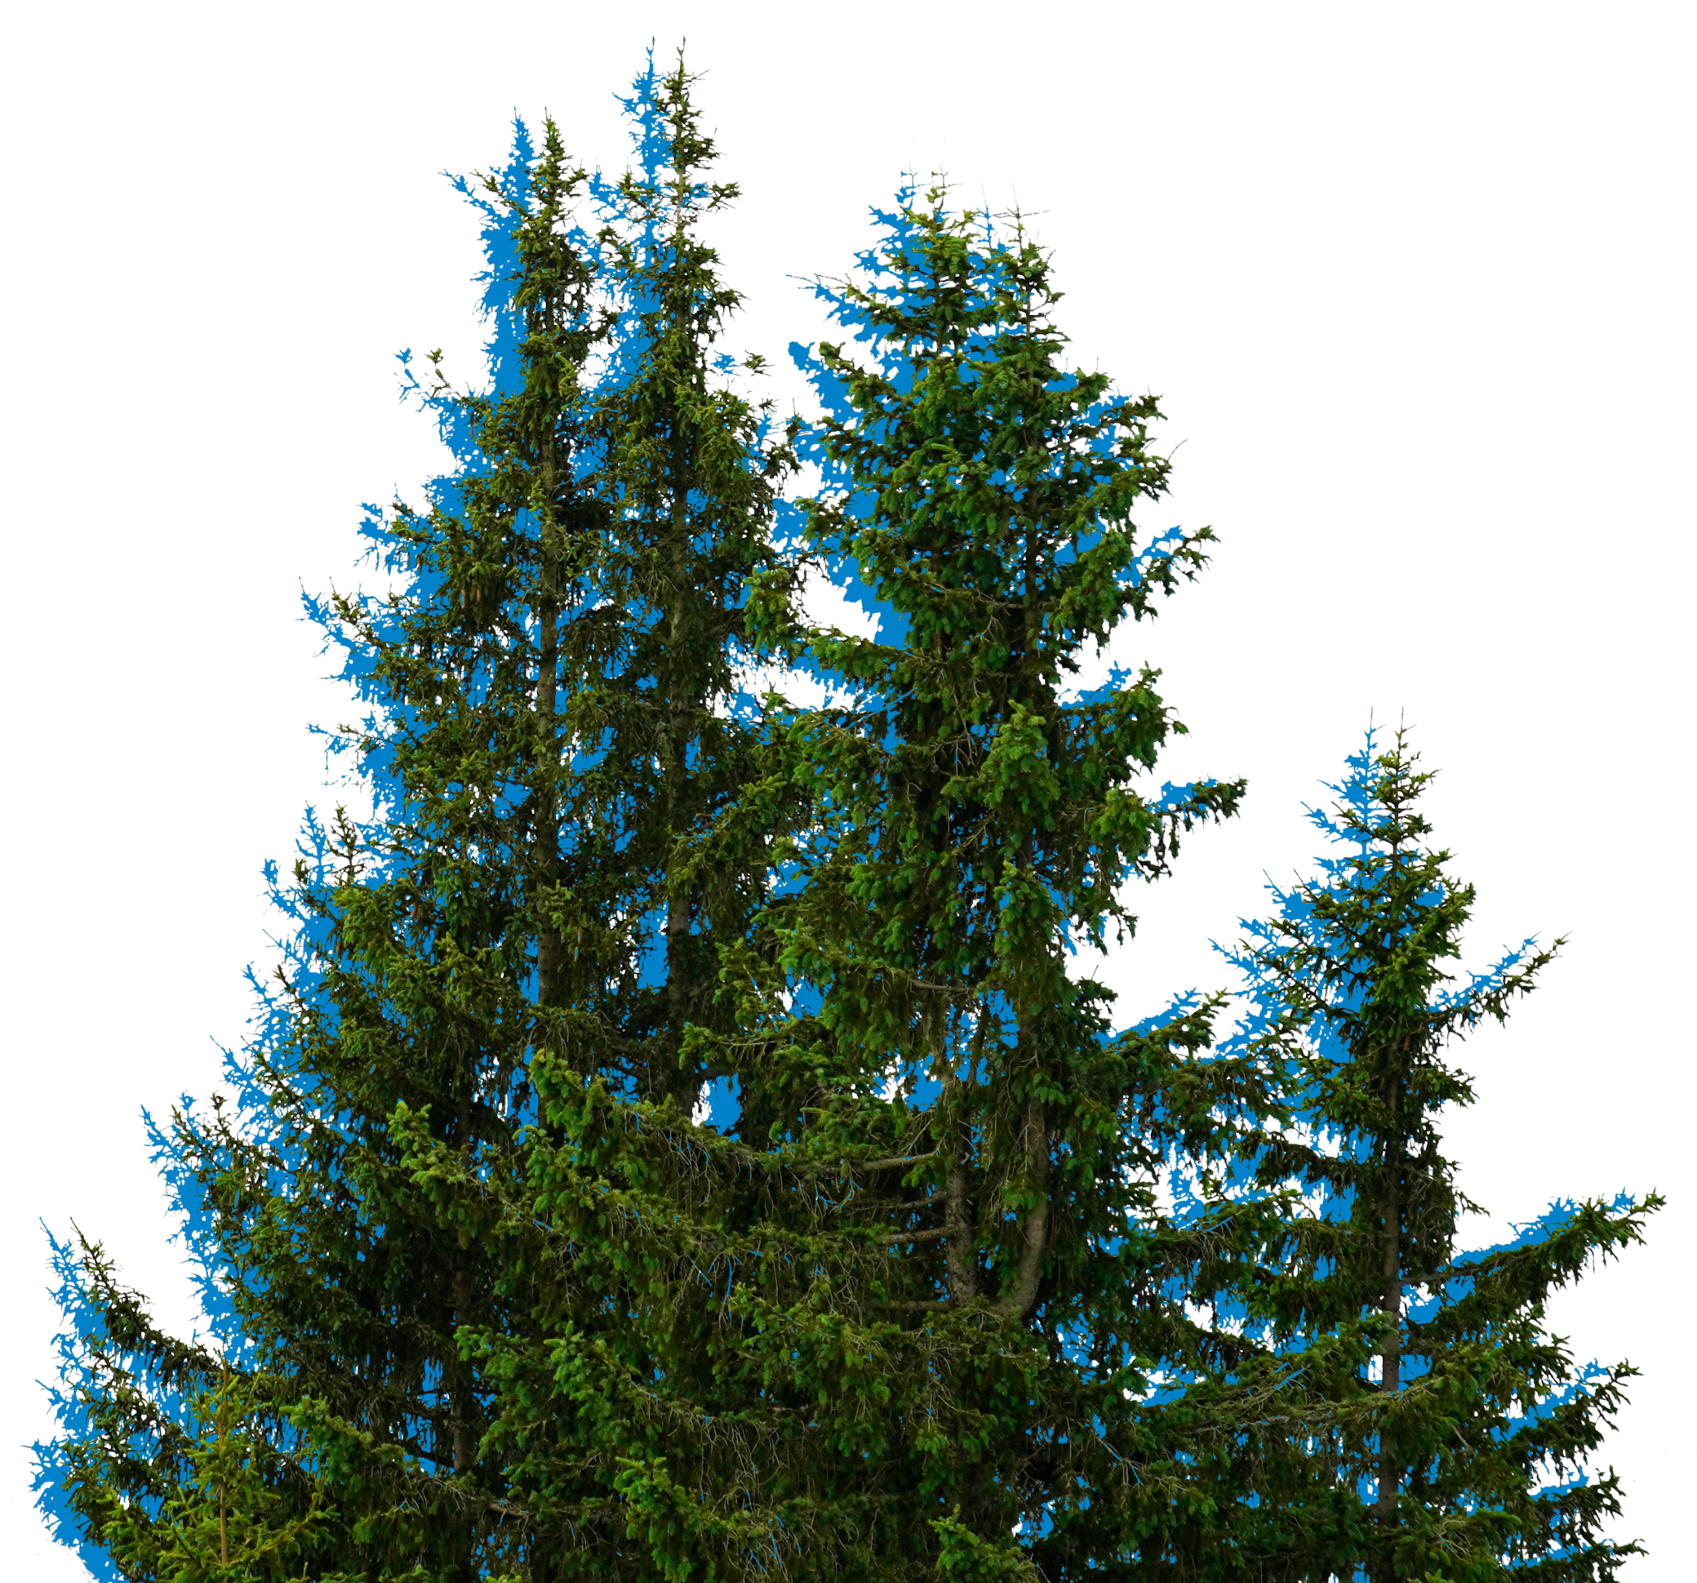
What the Senate Added
Expands prescribed fire activities, including federal agency support, implementation
Establishes interagency program to support wildfire resilience in communities
Expands permission for utilities to cut and remove vegetation near power lines
Creates grant opportunities for nurseries to help increase tree nursery capacities
Establishes White Oak Restoration Initiative
Notes:
https://www.publish.csiro.au/wf/Fulltext/WF22155

Slide 22

Status of FOFA
Passed House by a vote of 279 to 141
  215 Republican Yea
  64 Democratic Yea
9 more Democratic Yea votes compared to last Congress
California Democrats: 24 Yea, 15 Nay
Senate version introduced 11 April 2025
  Co-sponsored by Padilla (D-CA), Curtis (R-UT), Hickenlooper (D-CO), Sheehy (R-MT)
Senate Ag Committee hearing on 06 May
Notes:
CA Dems: 24 Yea, 15 Nay
https://clerk.house.gov/Votes/202525

Slide 23
Supporting Organizations
The Nature Conservancy; National Wildlife Federation; Environmental Defense Fund; National Audubon Society; Citizens’ Climate Lobby; Theodore Roosevelt Conservation Partnership; Rural Voices for Conservation Coalition; The Stewardship Project; the Federation of American Scientists; CAL FIRE; the International Association of Fire Chiefs; Alliance for Wildfire Resilience; Megafire Action; the Association for Firetech Innovation; Climate & Wildfire Institute; Tall Timbers; Bipartisan Policy Center Action (BPC Action); and Hispanics Enjoying Camping, Hunting, and the Outdoors (HECHO), American Forests

Slide 24
Opposing Arguments
Claim: FOFA will open up millions of acres of forests to clear cutting
Reality: FOFA expands existing categorical exclusions for emergency fireshed management projects from 3,000 to 10,000 acres per wildfire resilience project, but these projects still must meet stringent criteria:
  Maximize the retention of old-growth and large trees
  Consider the best available scientific information to maintain or restore ecological integrity
  Develop and implement plans through a collaborative process
Exception: fuel breaks, but they can be no more than 1,000 feet wide and must be contiguous with or incorporate existing infrastructure like roads, transmission lines.

Slide 25
More on Categorical Exclusions
Projects receiving up to a 10,000 acre CatEx must be identified by a fireshed assessment that complies with applicable forest plans developed with community input, the best available science, Tribal knowledge, and local participation, reducing the risk that CatExes will be used for projects harmful to forests
In order to qualify for CatEx, a project must meet at least one of the following land management goals:
(1) Road and trail maintenance or obliteration to restore or maintain water quality.
(2) Soil productivity, habitat for wildlife and fisheries, or other resource values.
(3) Setting of prescribed fires to improve the composition, structure, condition, and health of stands or to improve wildlife habitat.
(4) Removing vegetation or other activities to promote healthy forest stands, reduce fire hazards, or achieve other land management objectives.
(5) Watershed restoration and maintenance.
(6) Restoration and maintenance of wildlife and fish.
(7) Control of noxious and exotic weeds and reestablishing native plant species.

Slide 26
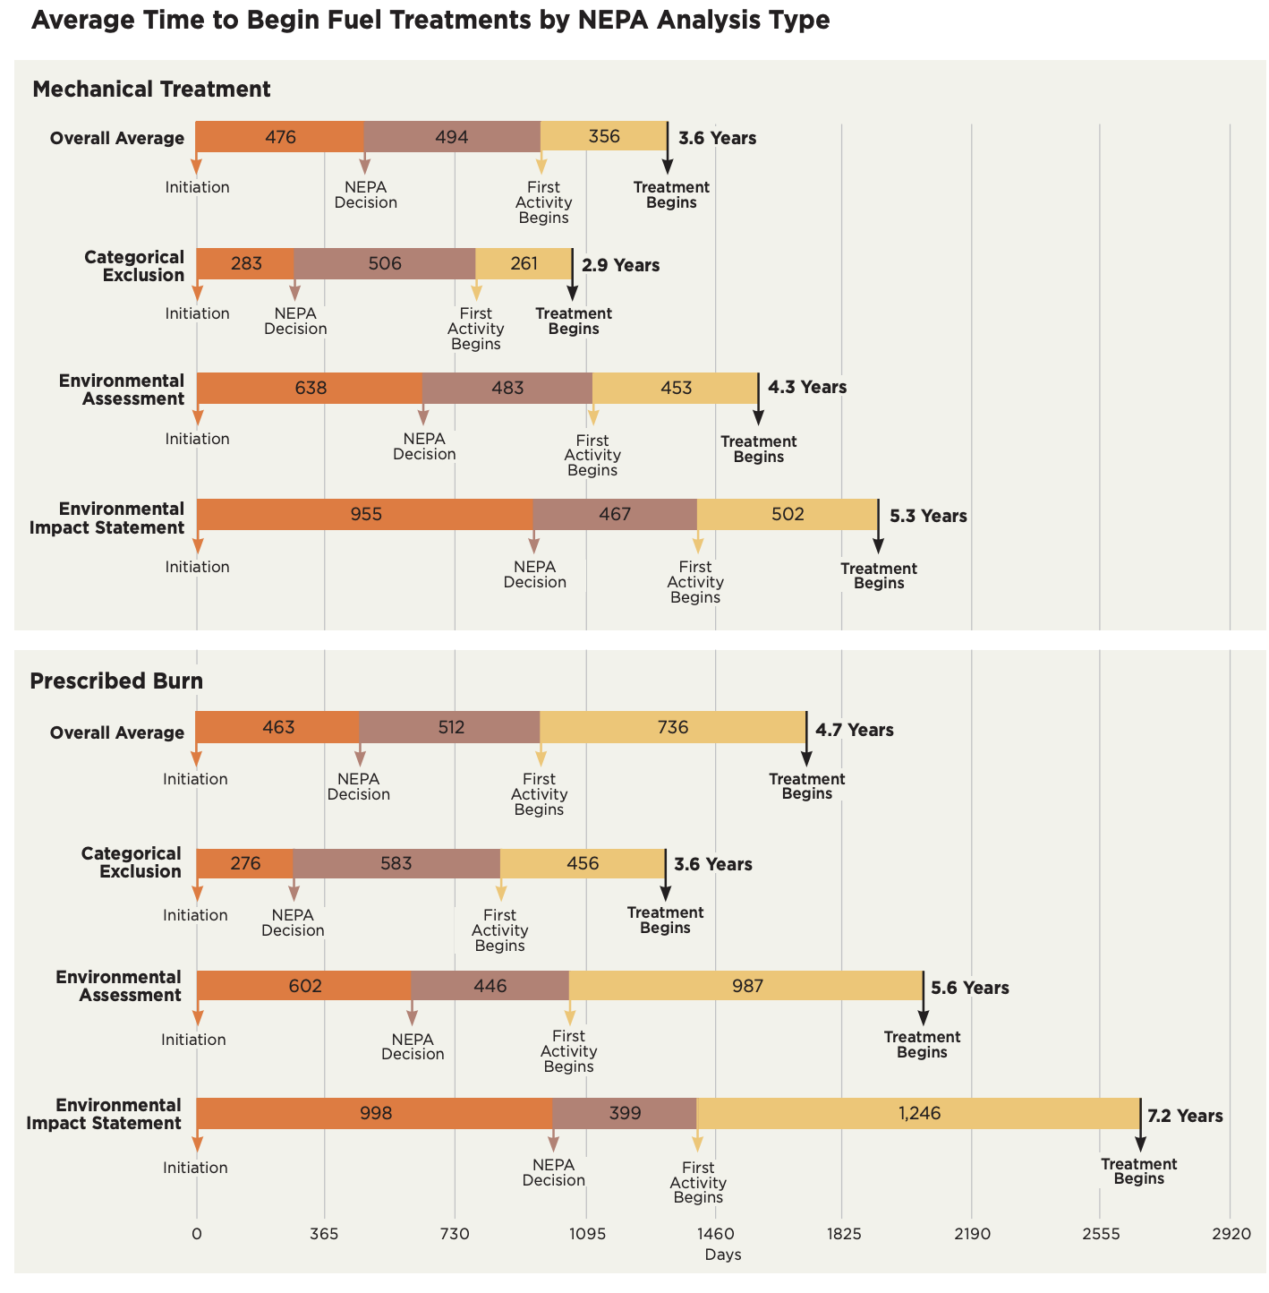
Why Categorical Exclusions are important:
They can reduce wildfire mitigation project timelines by 1 to 4 years
USFS estimates that 80 million acres need fuels treatment; current rate is less than 2 million per year
Notes:
https://www.perc.org/wp-content/uploads/2022/06/PERC-PolicyBrief-NEPA-Web.pdf

Slide 27
Opposing Arguments
Claim: FOFA will prevent the protection of endangered species
Reality: FOFA includes what is known as the “Cottonwood Fix” to prevent redundant agency consultations and project delays.

Slide 28
More on the Cottonwood Fix
The Cottonwood ruling said that if a new critical habitat is designated (like for an endangered species), the U.S. Forest Service must reinitiate consultation with wildlife agencies on their entire forest plan—even if no actual project is underway.
Why that’s a problem:
  It can force the Forest Service to pause all projects across a national forest.
  These pauses can last months or years, even if projects don’t directly affect the species or habitat.
  The Obama Administration argued against this policy stating the rule “has the potential to cripple the Forest Service”
  The fix in this legislation would revert things back, stating that the forest service does not have to re-do consultation for the whole forest plan every time critical habitat is updated—as long as consultation is happening at the project level

Slide 29
Opposing Arguments
Claim: FOFA will enable the administration’s Executive Order on timber production to allow forest clearcutting
Reality: The Executive Order directs a few agency heads to find ways to produce more timber from federal lands. But Fix Our Forests has very stringent criteria about what sort of projects can qualify for its fireshed management. Ecological forestry (ecological thinning + controlled burns) is very different from clearcutting.
Notes:
https://www.scienceforconservation.org/assets/downloads/EcologicalForestry_2019rev.pdf

Slide 30
Opposing Arguments
Claim: FOFA prevents citizens from holding federal agencies accountable
Reality: FOFA provides 150 days (approximately 5 months) for legal challenge filings, placing wildfire management plan litigation on the same standard as many surface transportation, energy, and aviation projects, and the same as proposed in the Energy Permitting Reform Act.
[for perspective, today we’re 109 days into the second Trump term]

Slide 31
More on Litigation Reform
Over the past decade, 80% of projects challenged under the National Environmental Policy Act were won on appeal by the US Forest Service and moved forward without any changes to the review.
These lawsuits delayed projects an average of nearly four years, during which time tens of millions of acres of American forests burned.

Slide 32

Next Steps
Legislative hearing on FOFA occurred this Tuesday. The US Forest Service's Acting Associate Chief Chris French testified and expertly addressed most concerns about the bill. It’s worth watching.
We expect the legislation to be marked up in the coming weeks. We are going to start with a small mobilization, targeting only Senate Agriculture Committee members.
Notes:
https://community.citizensclimate.org/discuss/viewtopic/3284/40855

Slide 33


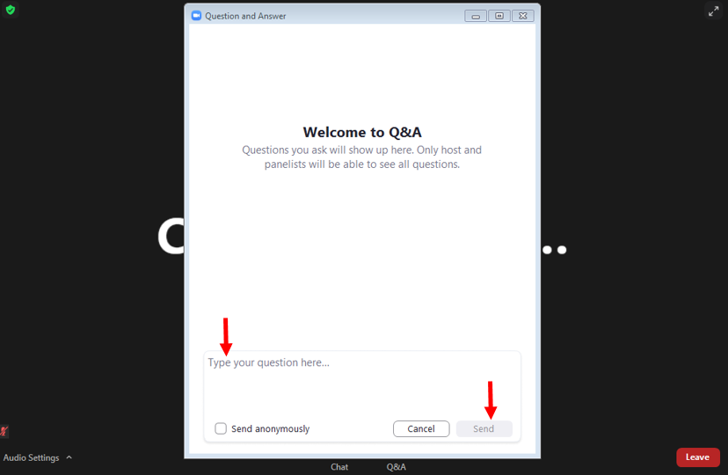
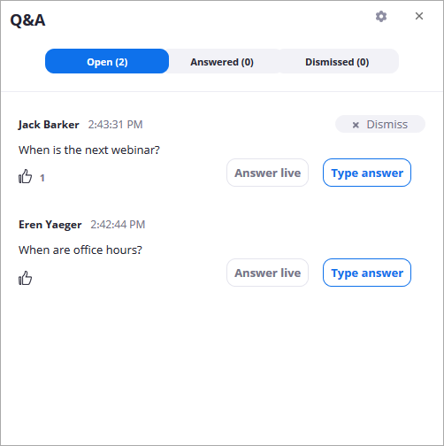
Time For Questions
Type in your questions to the Q&A Icon and Upvote Others’
Notes:
To "raise your (virtual) hand": On the meeting control toolbar across the bottom, click the Participants icon. Then in the Participants panel, find the gray button Raise Hand Icon (bottom right) or *9 on phone. (Or just say “I’m raising my hand” here in the chat.) :-)

Slide 34

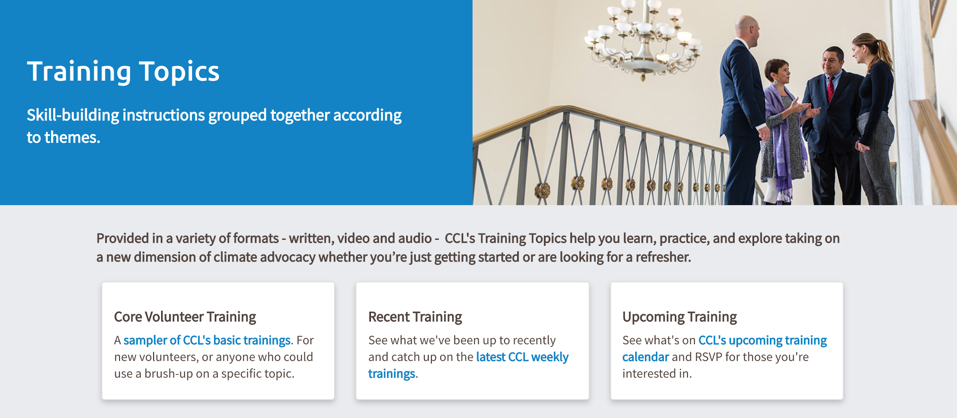
Poll For Your Feedback!
Saving Your Chat Log
Finding Recordings After Tonight
Share online, with social media, and with your chapter, family and friends!
community.citizensclimate.org/topics#recent-trainings
Notes:
Where to find trainings on Community—under Resources & Training Tab, you’ll see “all topics”, you can find trainings by specific categories: https://community.citizensclimate.org/topics#upcomingTraining
If you’ve found any of the links shared useful tonight and want to save the chat as a .txt file on your computer
Click on your chat window in Zoom
Move your mouse over to the triple dot - ellipsis button and click it
From the dropdown menu - click “Save Chat” and look for the .txt file where your computer saves downloads from the internet.

Slide 35
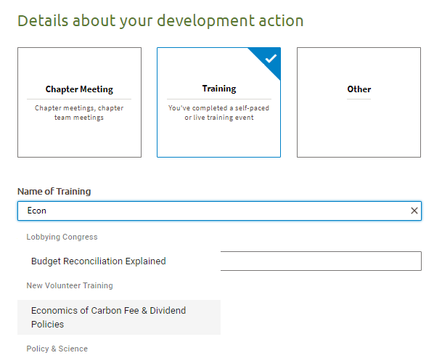
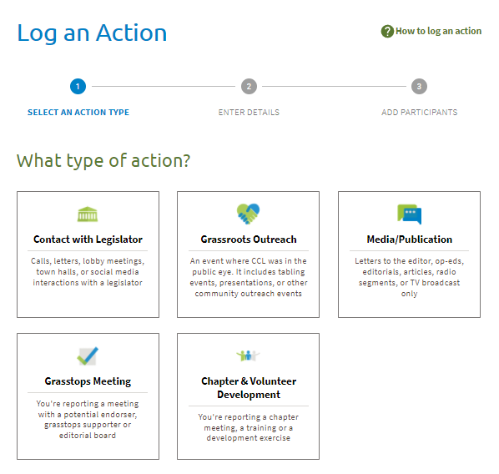
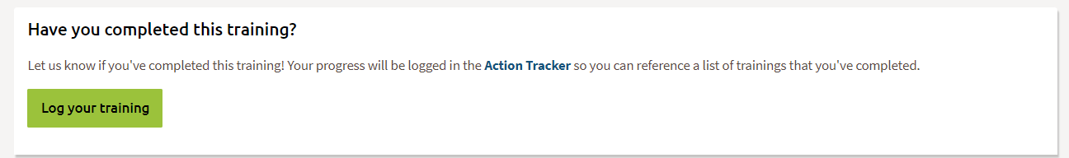
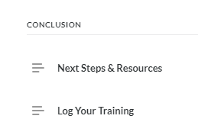
Log Your Training
Through the Action Tracker:
At the End of each Training:
Notes:
If you’d like to log the fact that you attended this training, click the link in the chat and this will automagically log this training for you in the Action Tracker
https://community.citizensclimate.org/log_training?sf_id=a5yUP0000009w9dYAA

Slide 36
Thank You!
Emails: Dana.Nuccitelli@citizensclimate.org
Jennifer.Tyler@citizensclimatelobby.org
Danny@citizensclimatelobby.org
Nerd Corner link: cclusa.org/nerd-corner
Questions? Ask on CCL Community’s Forums: https://community.citizensclimate.org/forums
Notes:
You might like to join the Nerd Corner Action Team to stay current on all things nerd climate science and post questions in the team forum, https://cclusa.org/nerd-corner
You can also post on CCL Community’s Sitewide Forums: https://community.citizensclimate.org/forums
CCL training Feedback: https://forms.gle/pb4Dr5wKW57Mg5bw5

